Slide 1
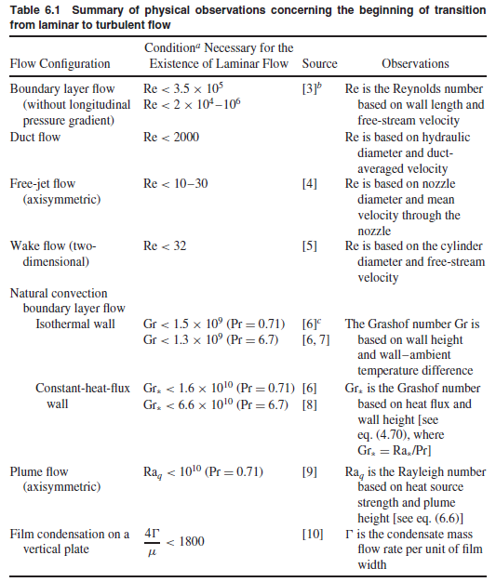

Slide 2
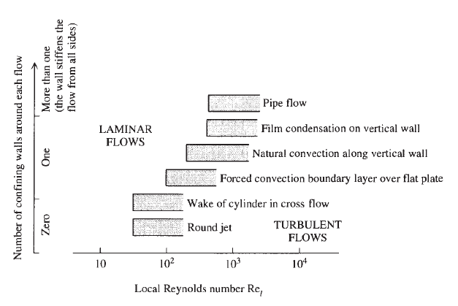

Slide 3
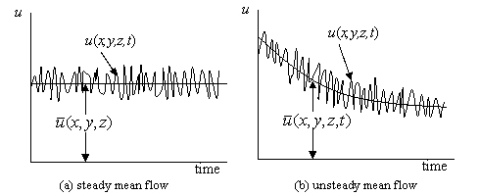
Turbulent velocity
Time dependence of velocity component in the x-direction in a turbulent flow

Slide 4

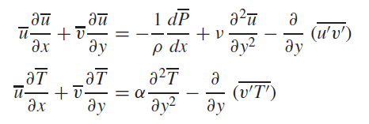
Boundary layer equations
(1)
(2)
(3)

Slide 5
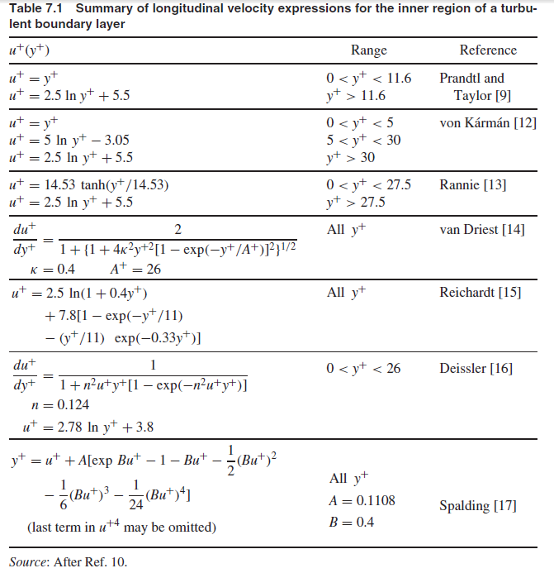

Slide 6
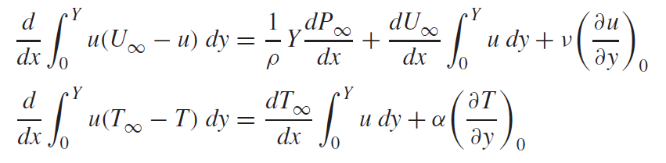
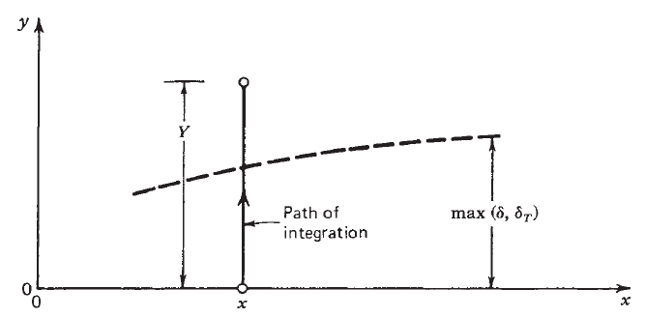
Integral solutions
Integral boundary layer equations for momentum and energy
(1)
(2)

Slide 7
Problem 4
A viscous liquid metal is flowing on the top of a flat insulating plate. Consider the laminar boundary layer frictional heating parallel to a free stream. Due to the viscous nature of the fluid, internal friction generates heat, which affects the temperature distribution within the boundary layer.
(i) Write the relevant energy boundary layer equation starting from the general energy conservation expression.
(ii) Use scaling arguments to estimate which mode of heat transfer will dominate for low Pr fluids and High Pr fluids. Assume the physical properties are temperature-independent and that the Blasius velocity solution scale is valid.
(iii) Estimate the scale of the thermal boundary layer for High Pr fluids.

